Slide 1
GN22ADMJFS003 Online MeDICAL PORTAL (MED EXPRESS)
POD -2
Karthigeyan G J - Pod Leader
Rutvik Ashok Tathod - POD MEMBER
Nithisha Boya - Pod member
Rachit Gupta - POD MEMBER
Bhawesh Chawla - POD MEMBER
Mentor: Tanmay Ghoshal
Trainer: Dhanvarshini Singaravelan
Coach: Shivam Gupta

Slide 2
CASE STUDY:
The main objective of our project is to construct a web application for a hospital that assists in providing valuable information and services to users in a more user-friendly manner, hence resolving critical hurdles.
We noticed various setbacks for users recently during the pandemic, such as a lack of information on the availability of doctors, beds, ambulance service, blood requirements, and so on. For a doctor’s appointment, users used to wait in line for several hours. They were uninformed of the hospital’s bed availability as well as the facilities accessible. The absence of all this information was a serious problem for the users.
Our initiative is centred on resolving these user issues. So, we would like to create an application that would tell the users about the services available at that hospital. We would allow users to plan appointments with doctors based on their schedules, allowing them to save time waiting in long queues. We would assist them to know the availability of hospital beds and blood requirements by constantly updating the information. We would make it possible for users to learn about the availability of ambulance services.
These are some of the most important features we want to include in the application. This would benefit the hospital, allowing them to serve users more efficiently.

Slide 3
APPLICATION ARCHITECTURE:
User Interface – React and Bootstrap
Service Layer – Spring Boot with REST
Business Layer – POJO, Service classes
Data Access Layer – Spring Data JPA
Back End Database – MySQL
Development Tools – Eclipse

Slide 4
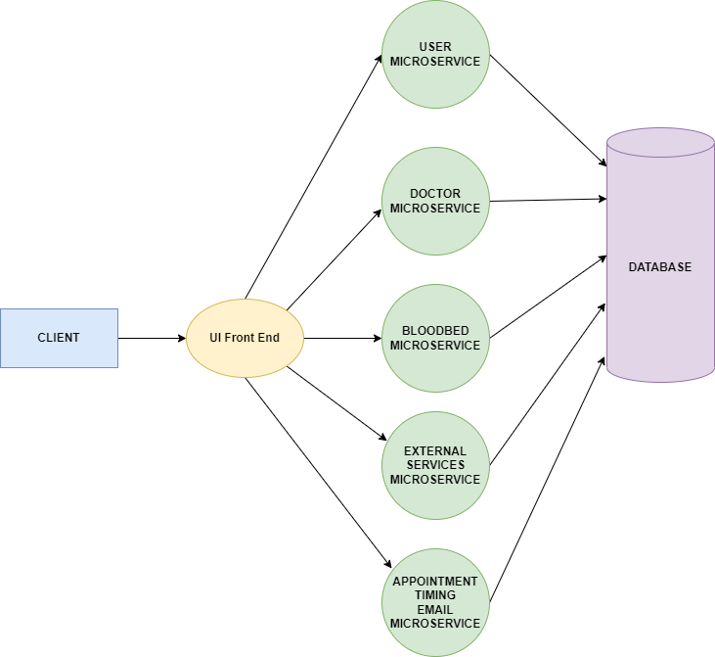
SYSTEM ARCHITECTURE DIAGRAM:

Slide 5
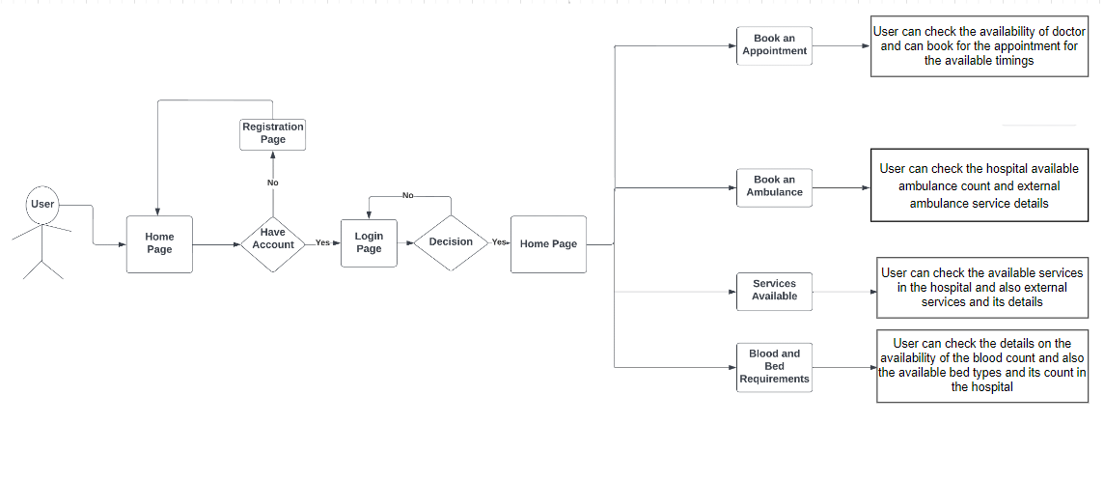
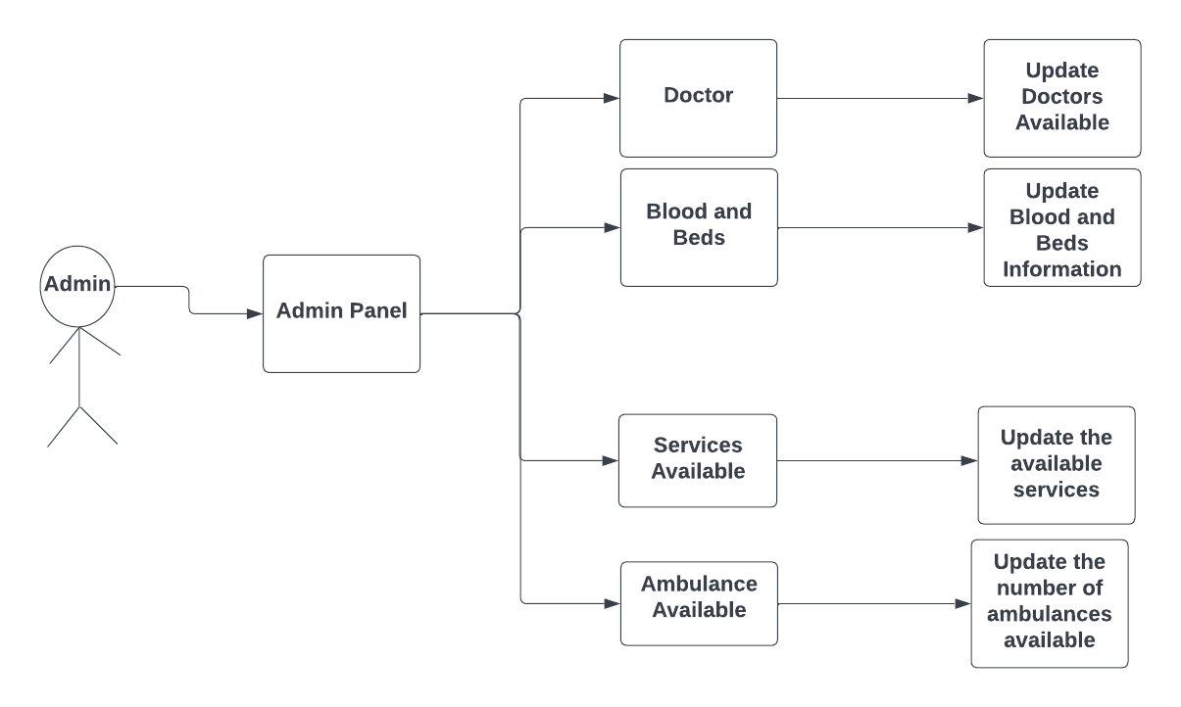
FLOW CHART:

Slide 6
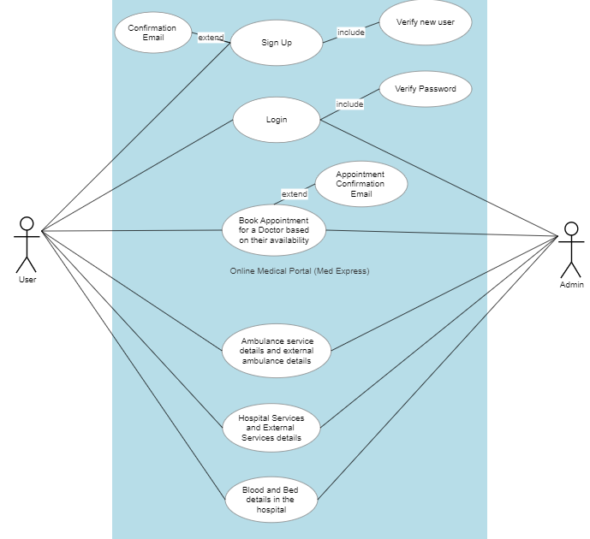
USE CASE DIAGRAM:

Slide 7
LIST OF MICROSERVICES:
USER MICROSERVICE
DOCTOR MICROSERVICE
BLOODBED MICROSERVICE
EXTERNAL SERVICES MICROSERVICE
APPOINTMENT-TIMING-EMAIL MICROSERVICE
EUREKA SERVER MICROSERVICE

Slide 8
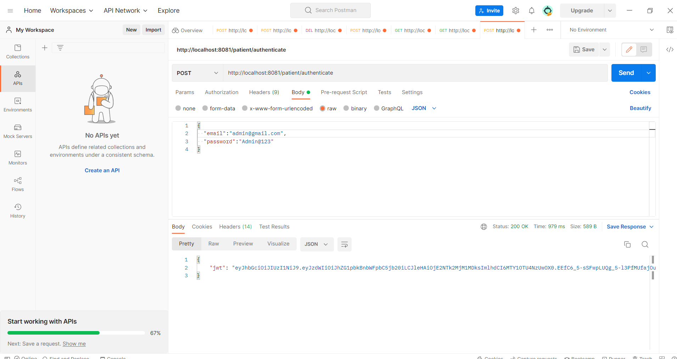
API TESTING SCREENSHOTS:

Slide 9
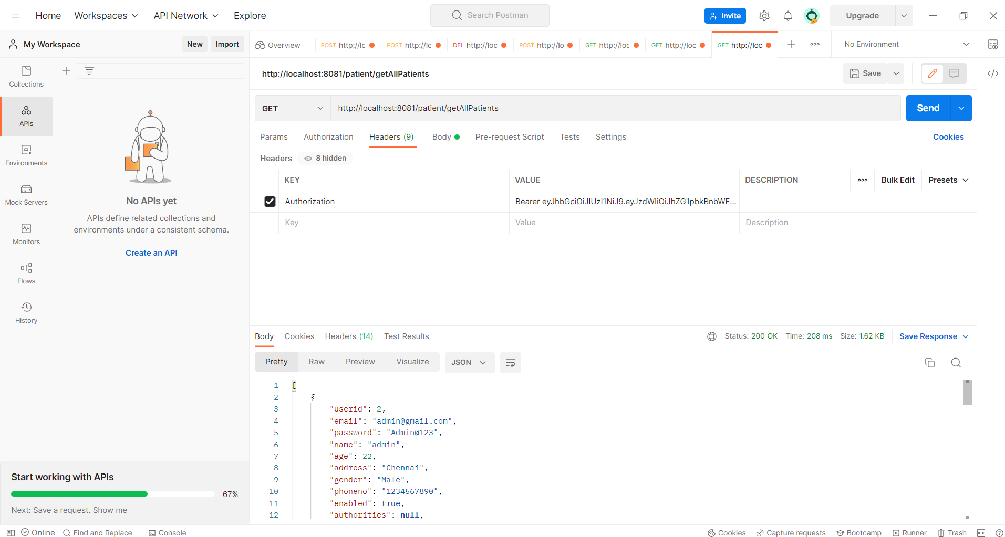
API TESTING SCREENSHOTS:

Slide 10
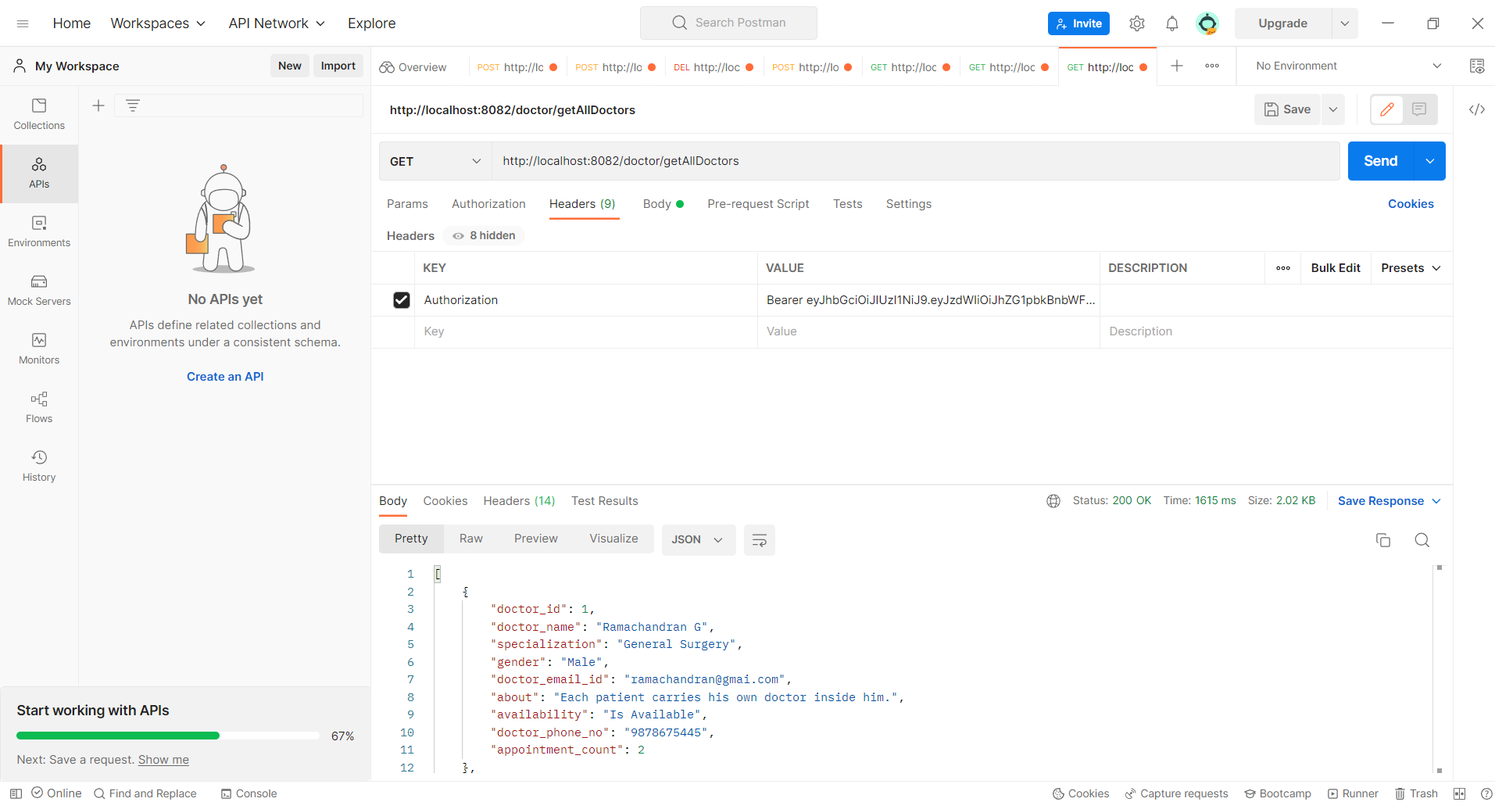
API TESTING SCREENSHOTS:

Slide 11
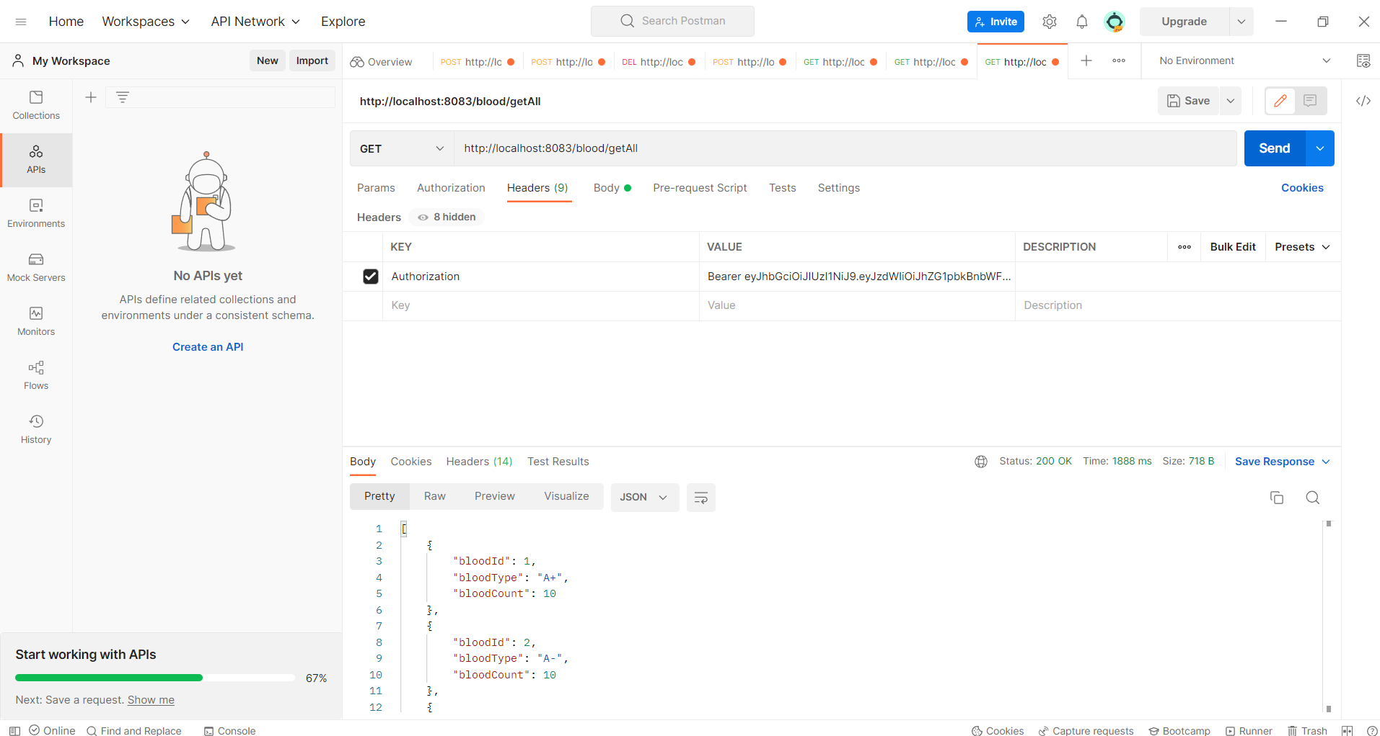
API TESTING SCREENSHOTS:

Slide 12
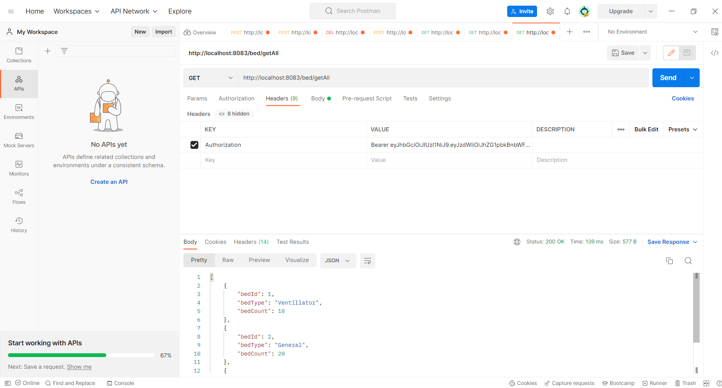
API TESTING SCREENSHOTS:

Slide 13
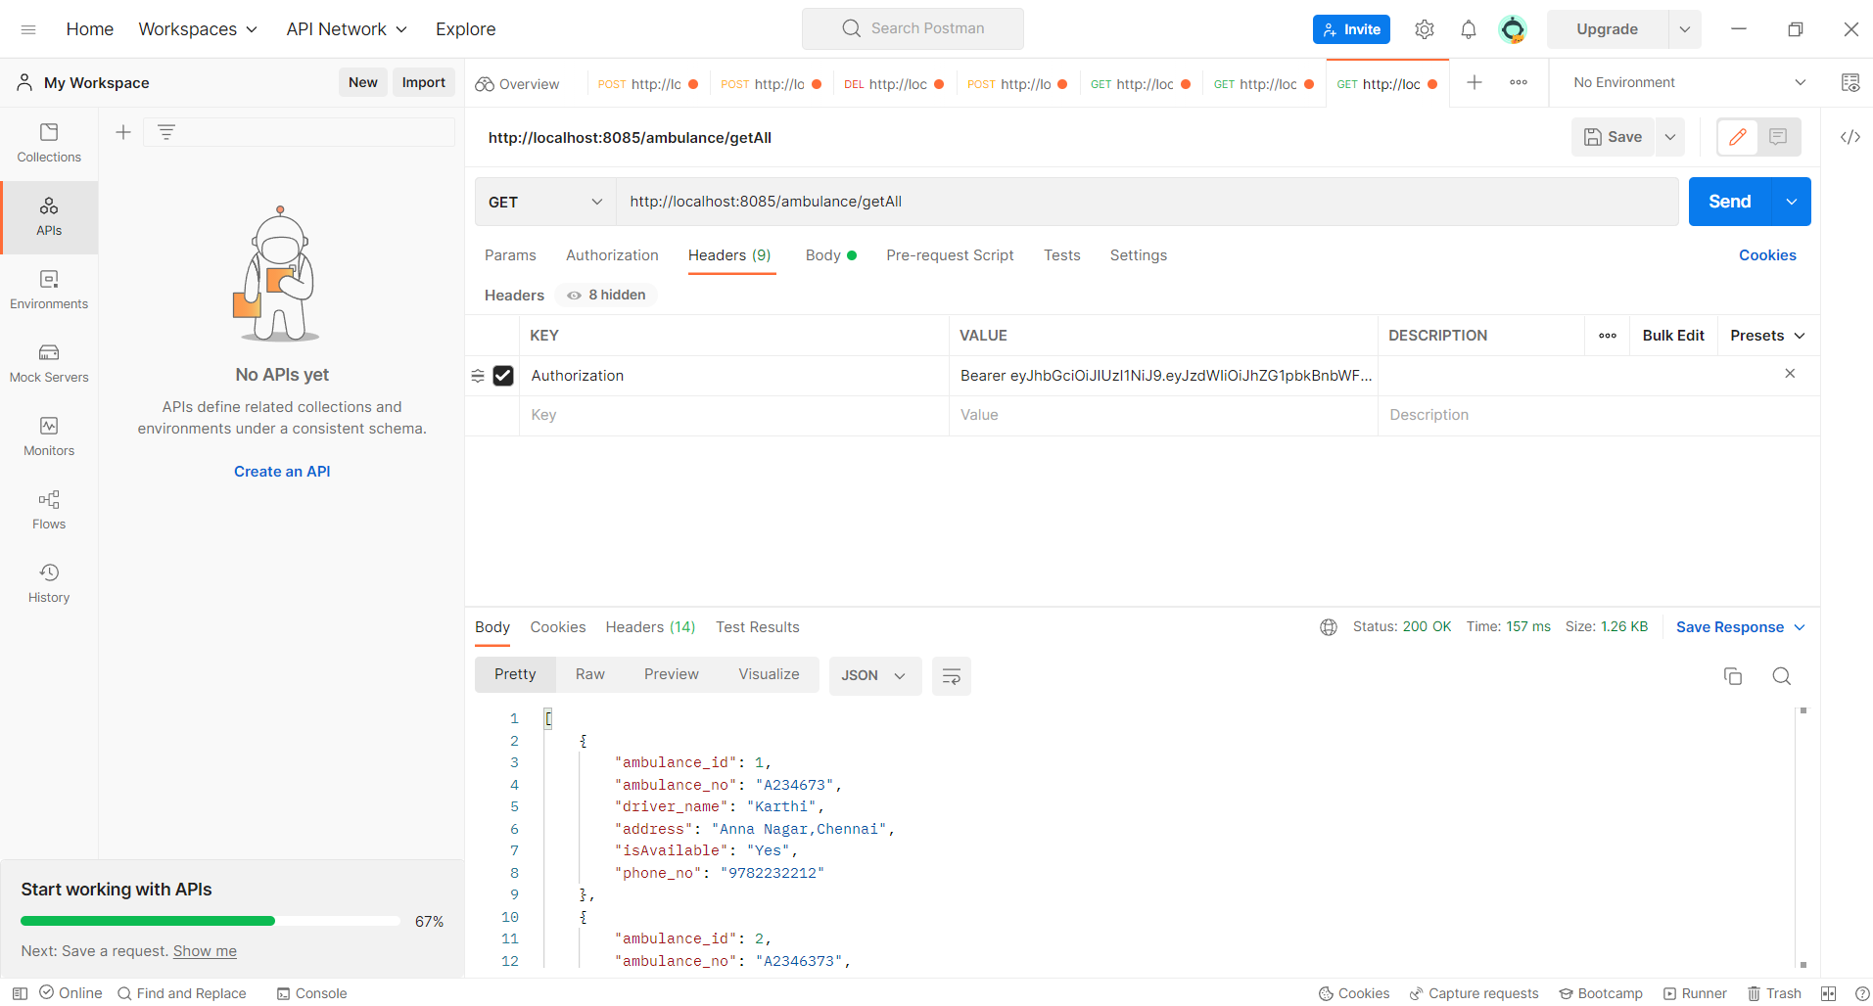
API TESTING SCREENSHOTS:

Slide 14
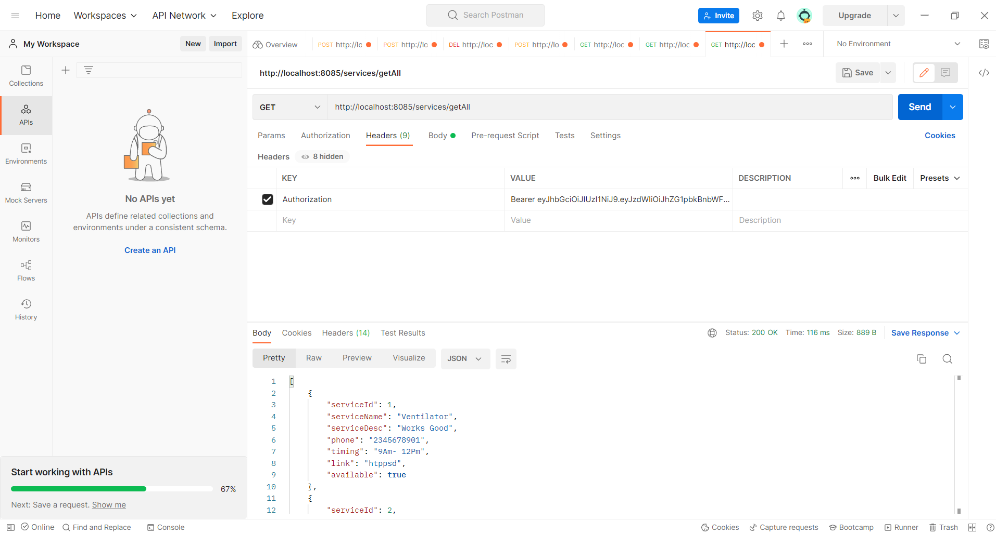
API TESTING SCREENSHOTS:

Slide 15
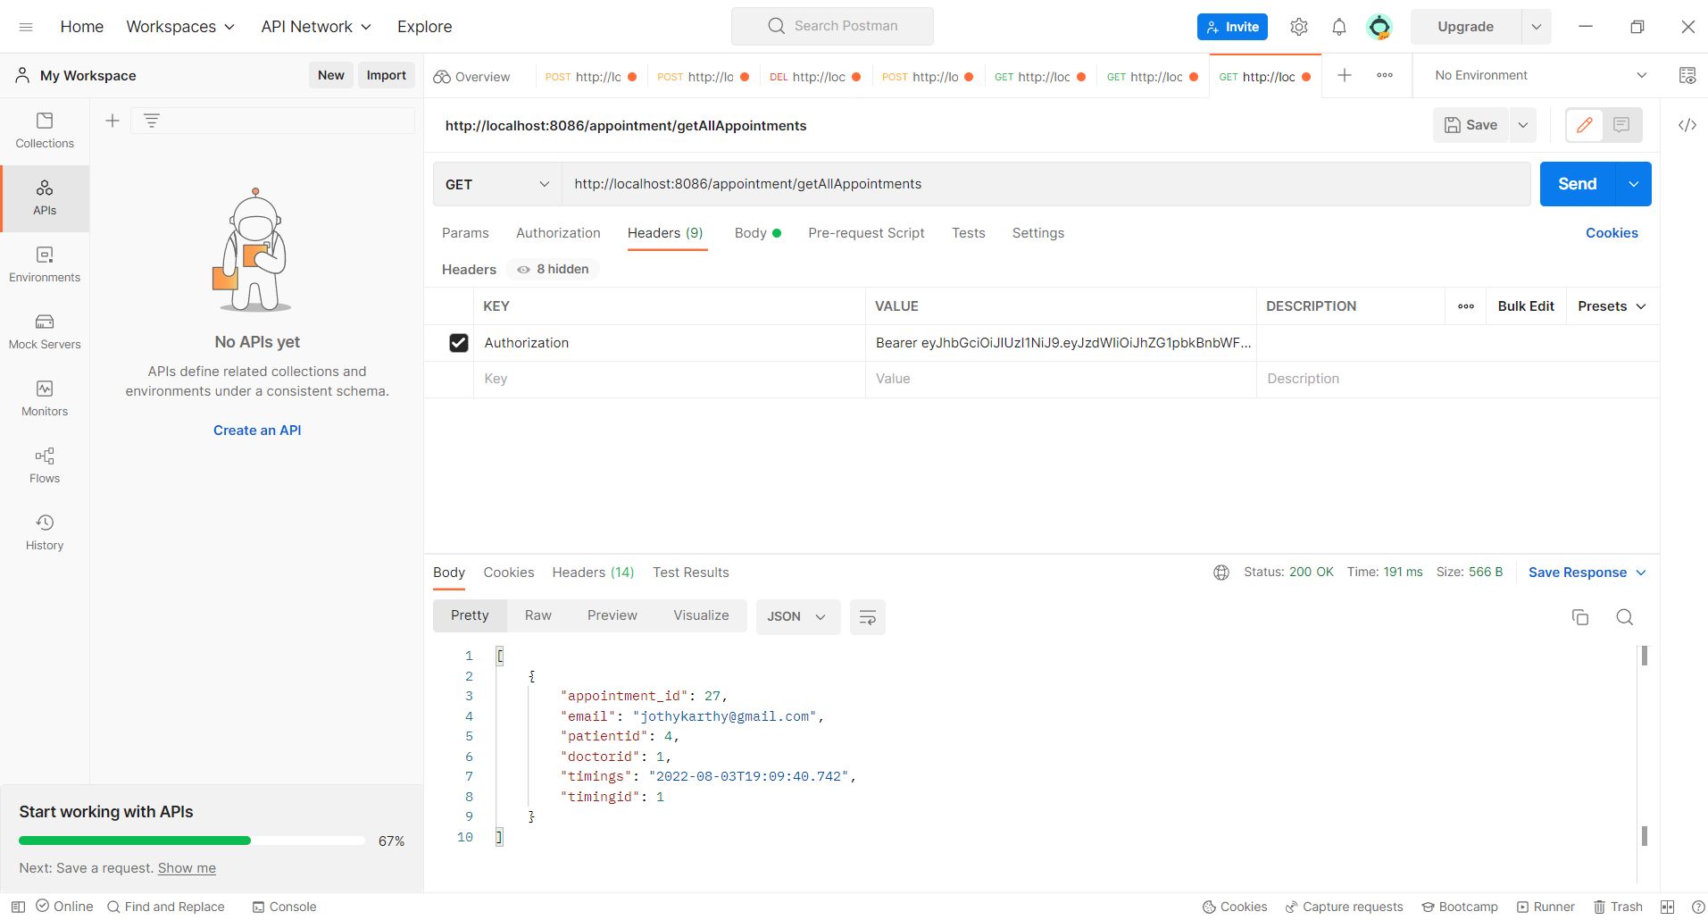
API TESTING SCREENSHOTS:

Slide 16
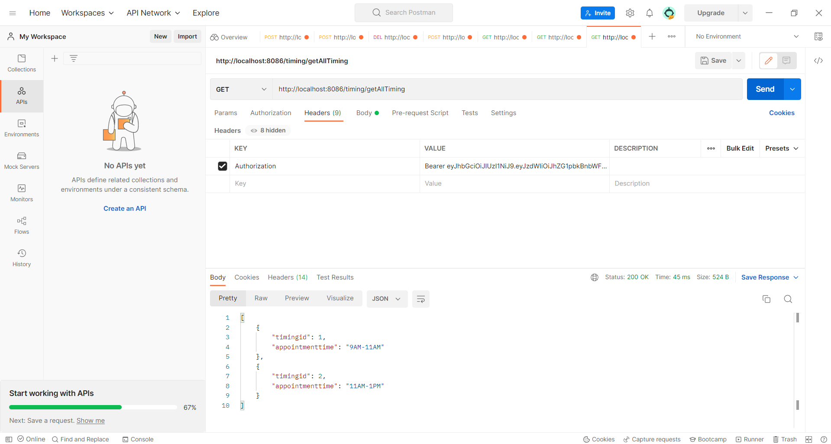
API TESTING SCREENSHOTS:

Slide 17
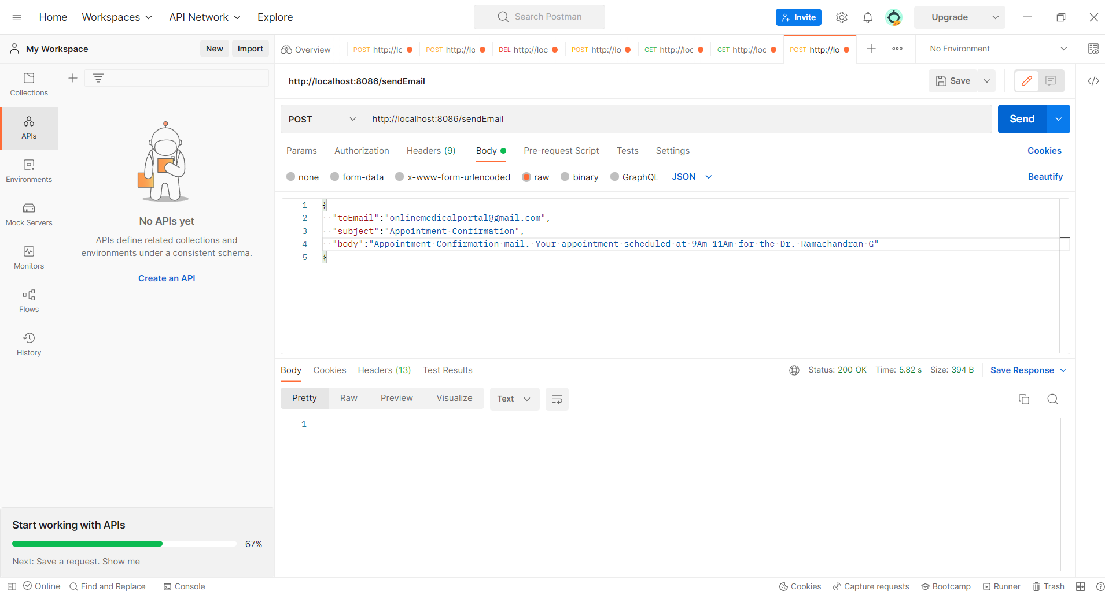
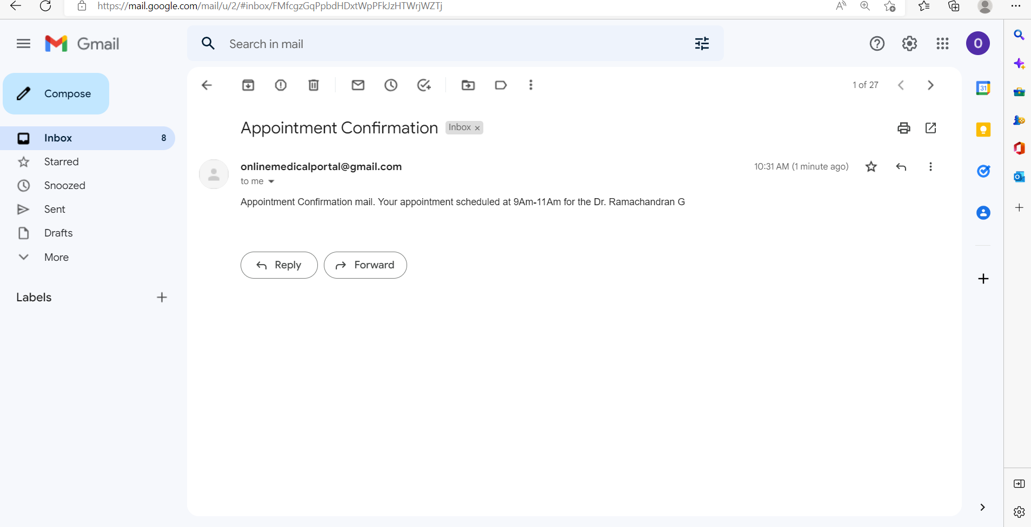
API TESTING SCREENSHOTS:

Slide 18
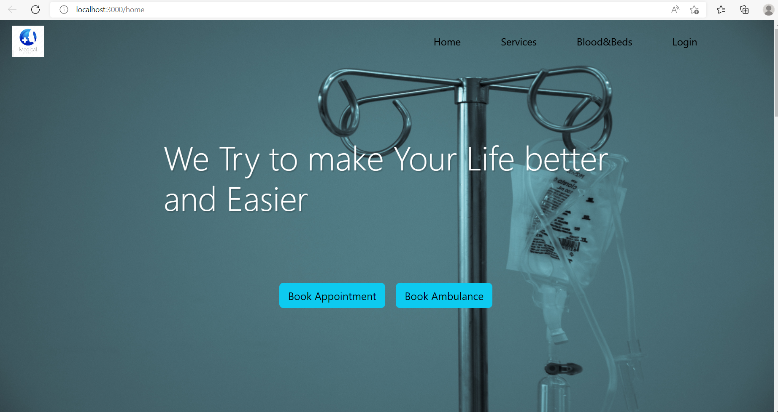
FRONTEND SCREENSHOTS:

Slide 19
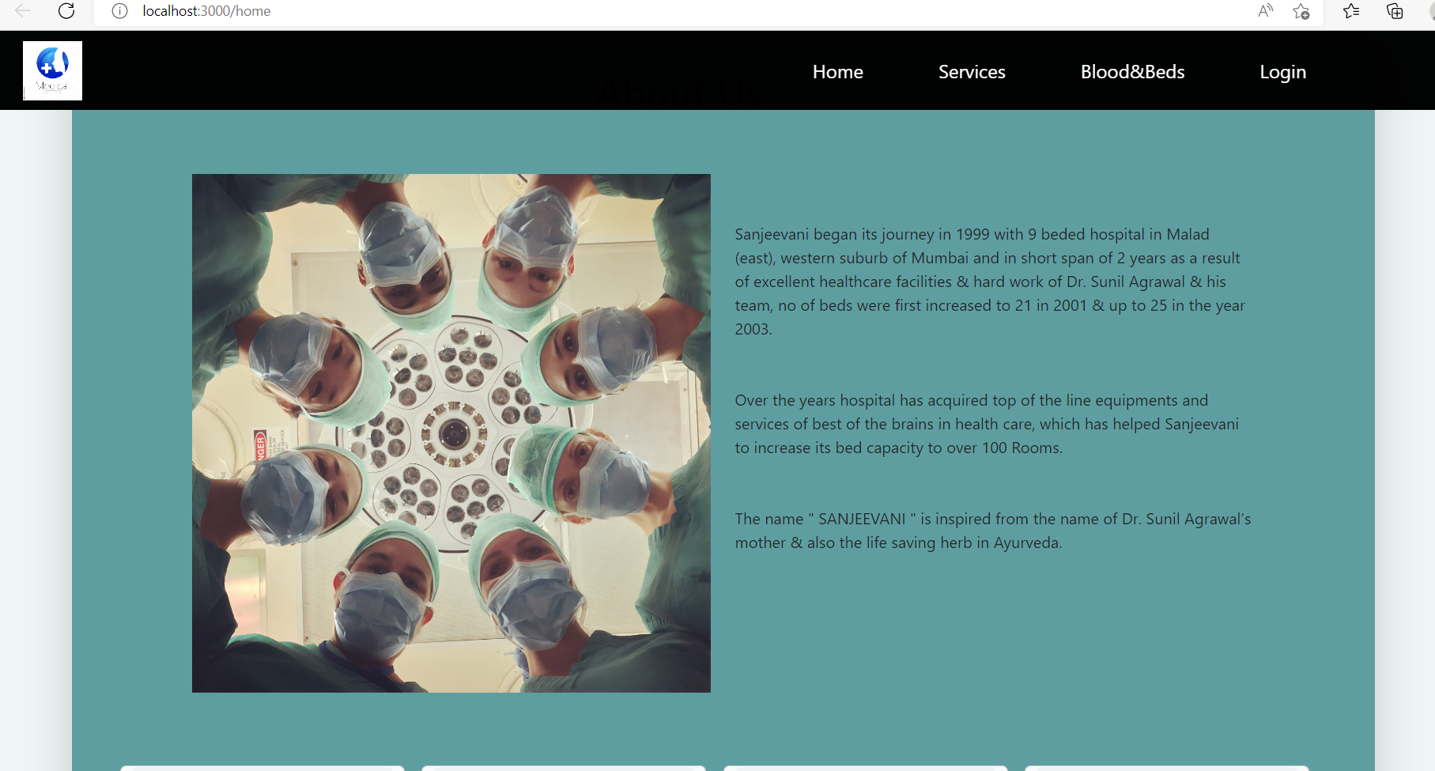
FRONTEND SCREENSHOTS:

Slide 20
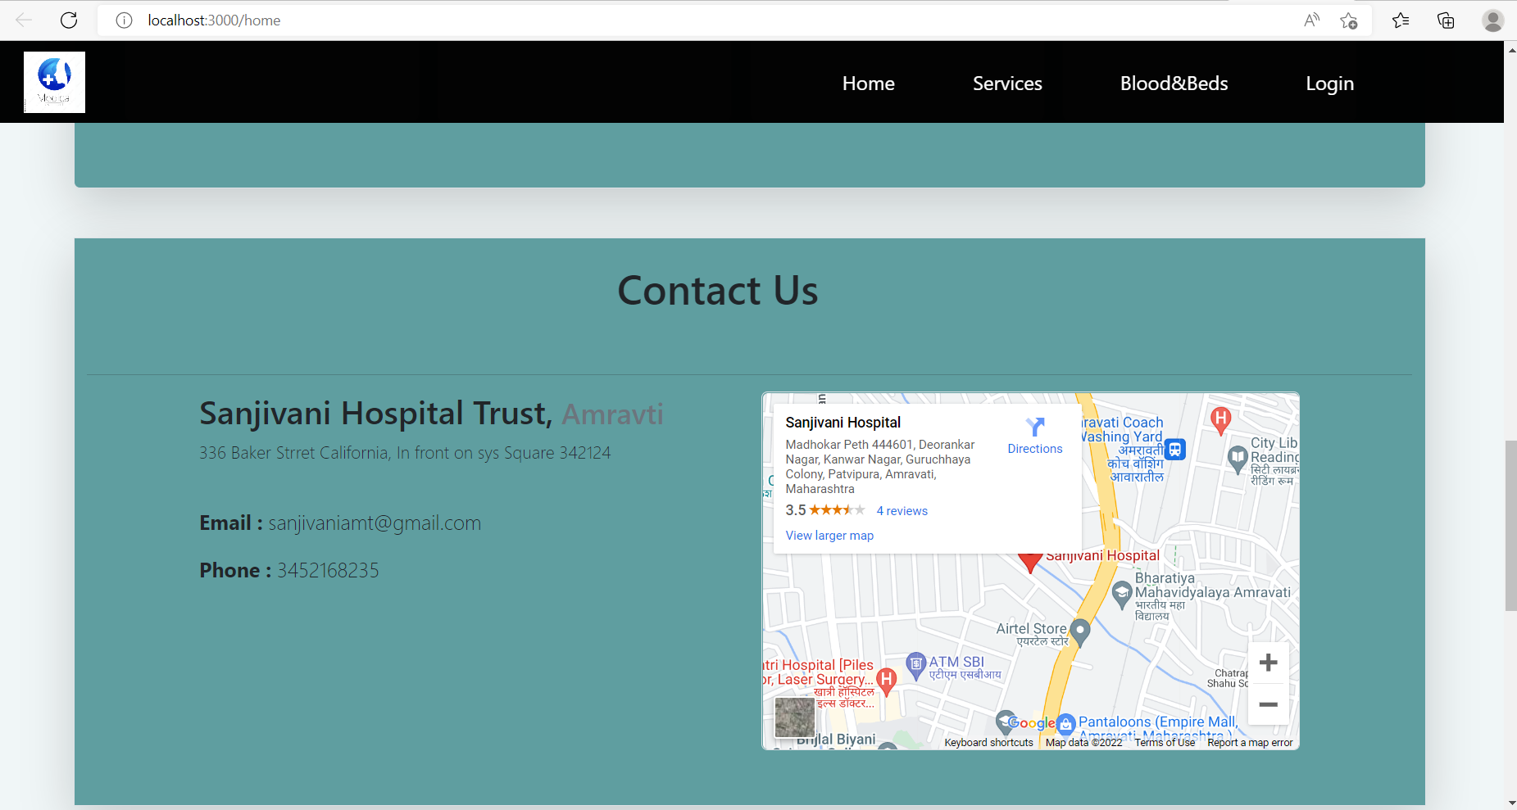
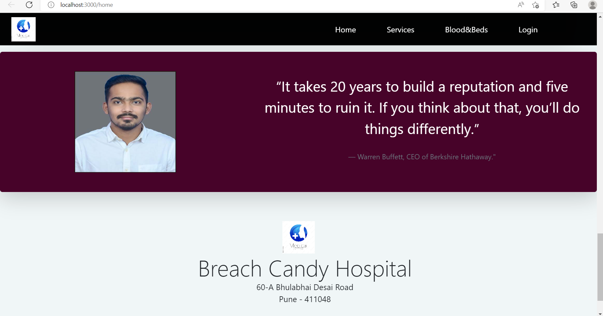
FRONTEND SCREENSHOTS:

Slide 21
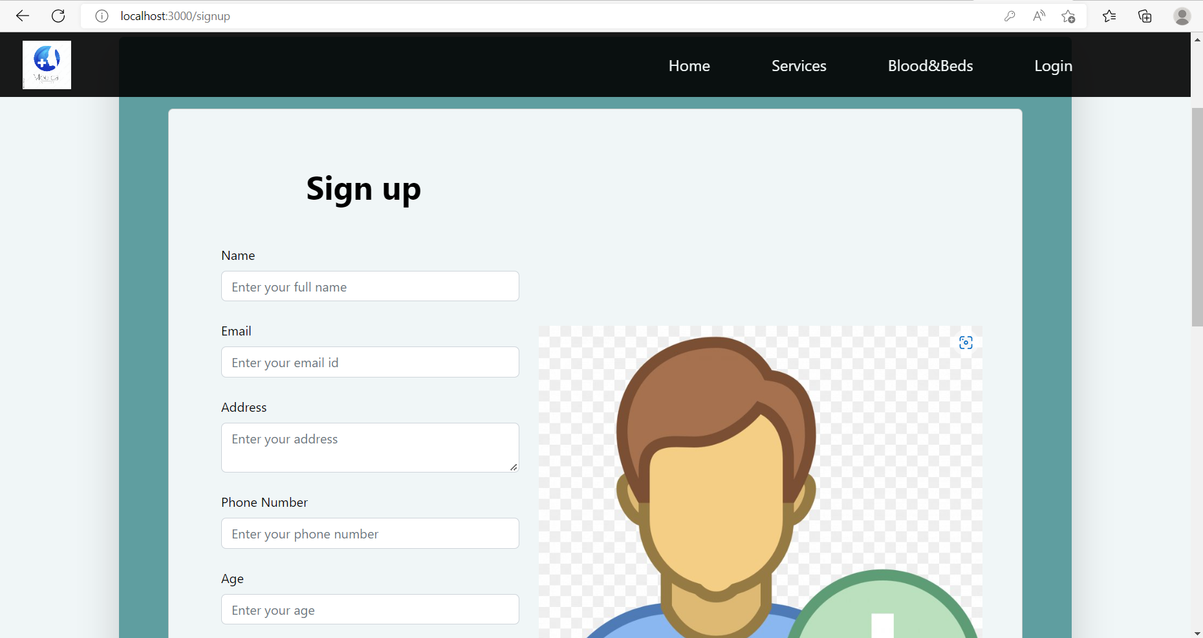
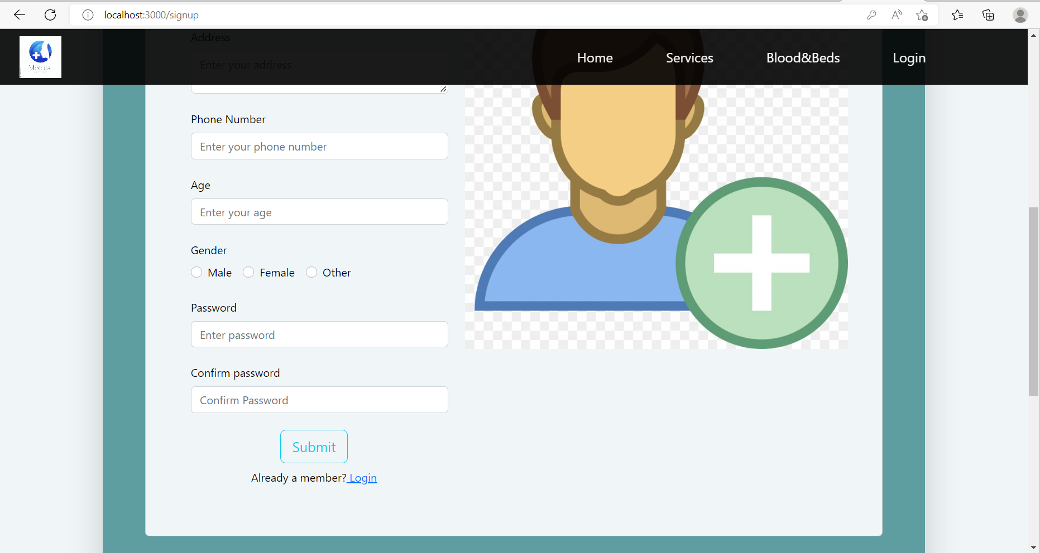
FRONTEND SCREENSHOTS:

Slide 22
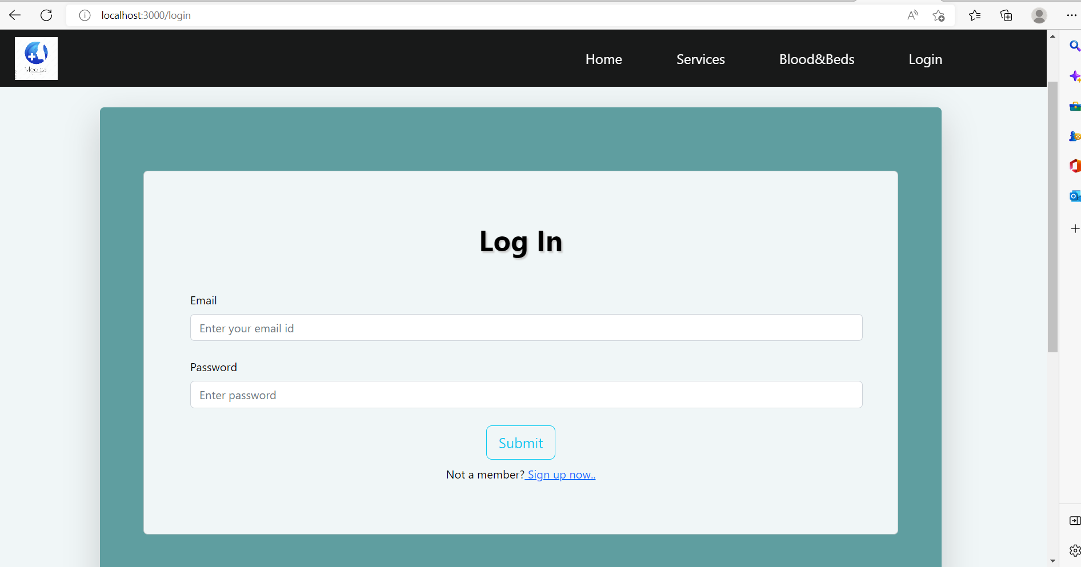
FRONTEND SCREENSHOTS:

Slide 23
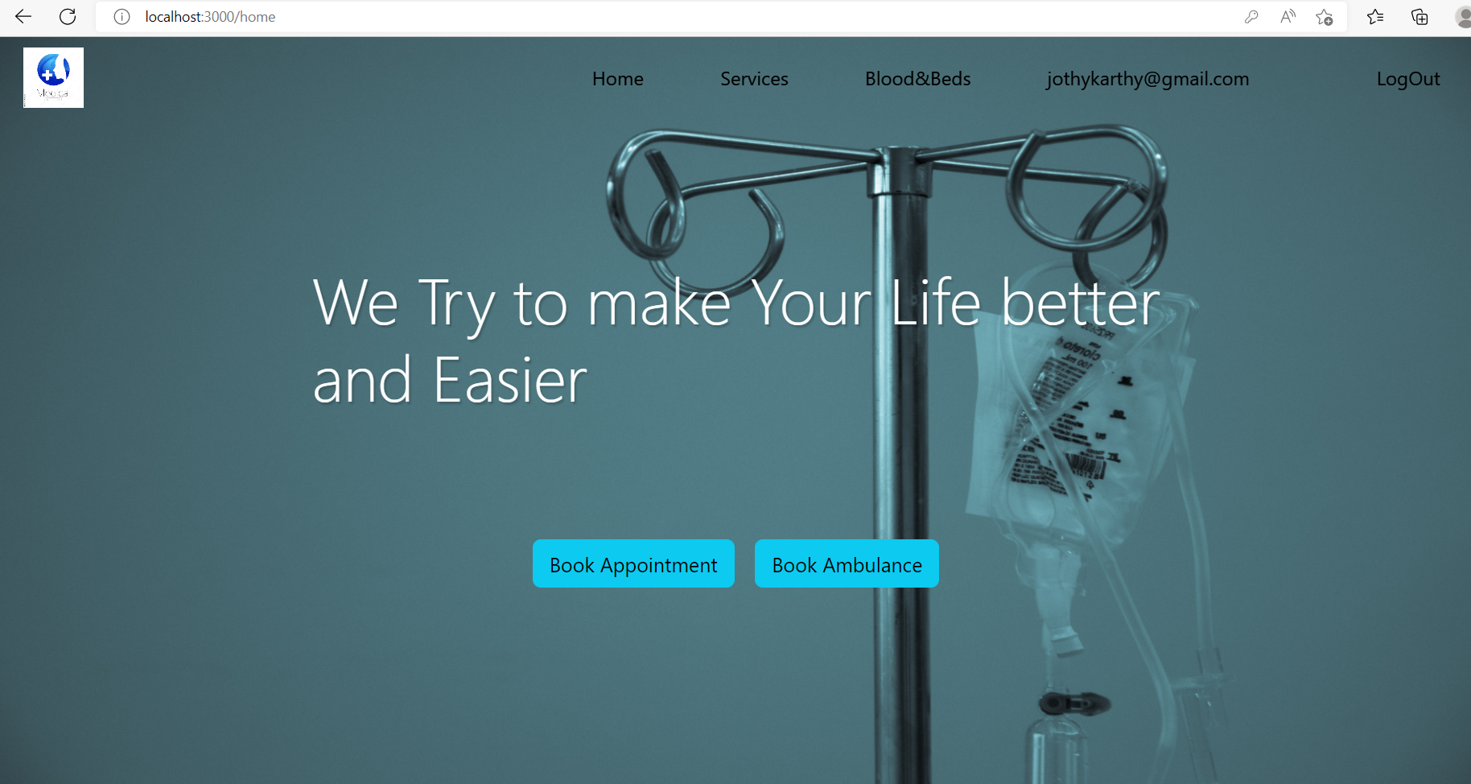

FRONTEND SCREENSHOTS:

Slide 24
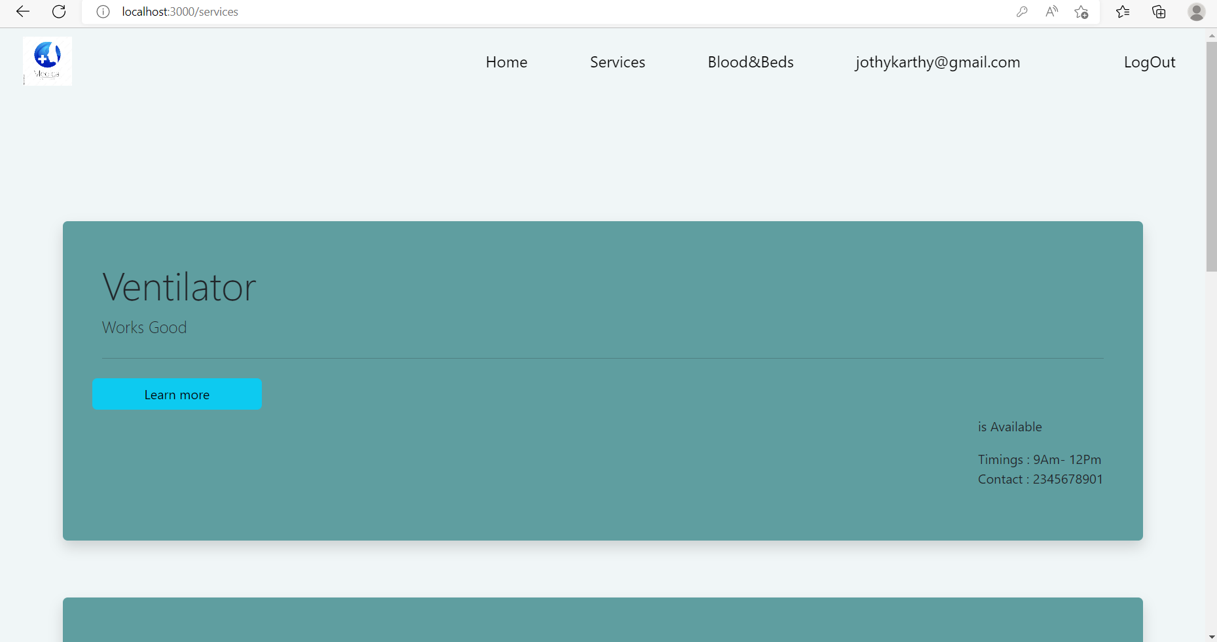
FRONTEND SCREENSHOTS:

Slide 25
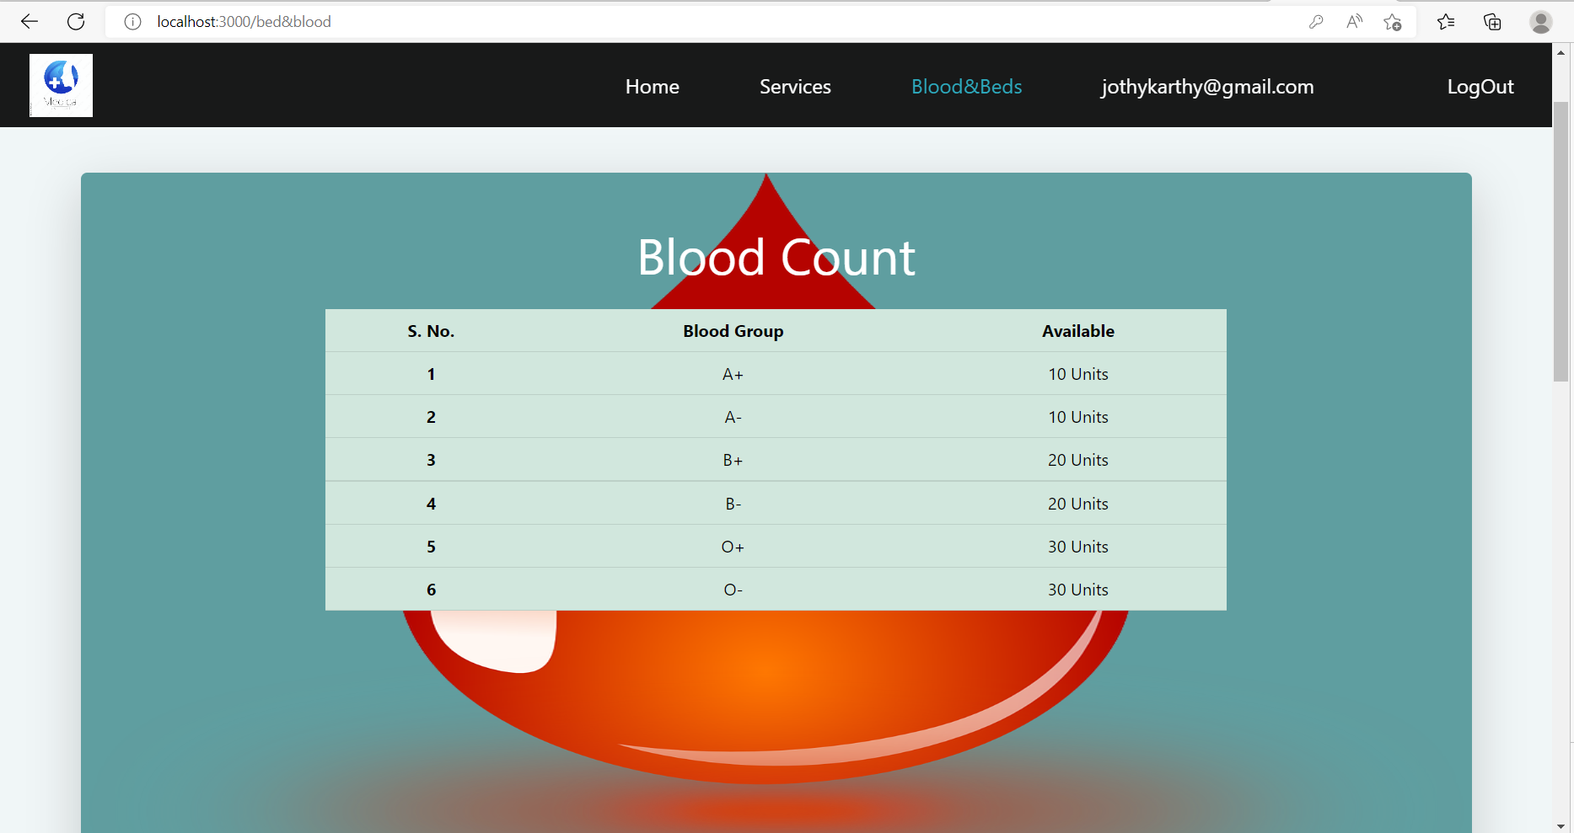
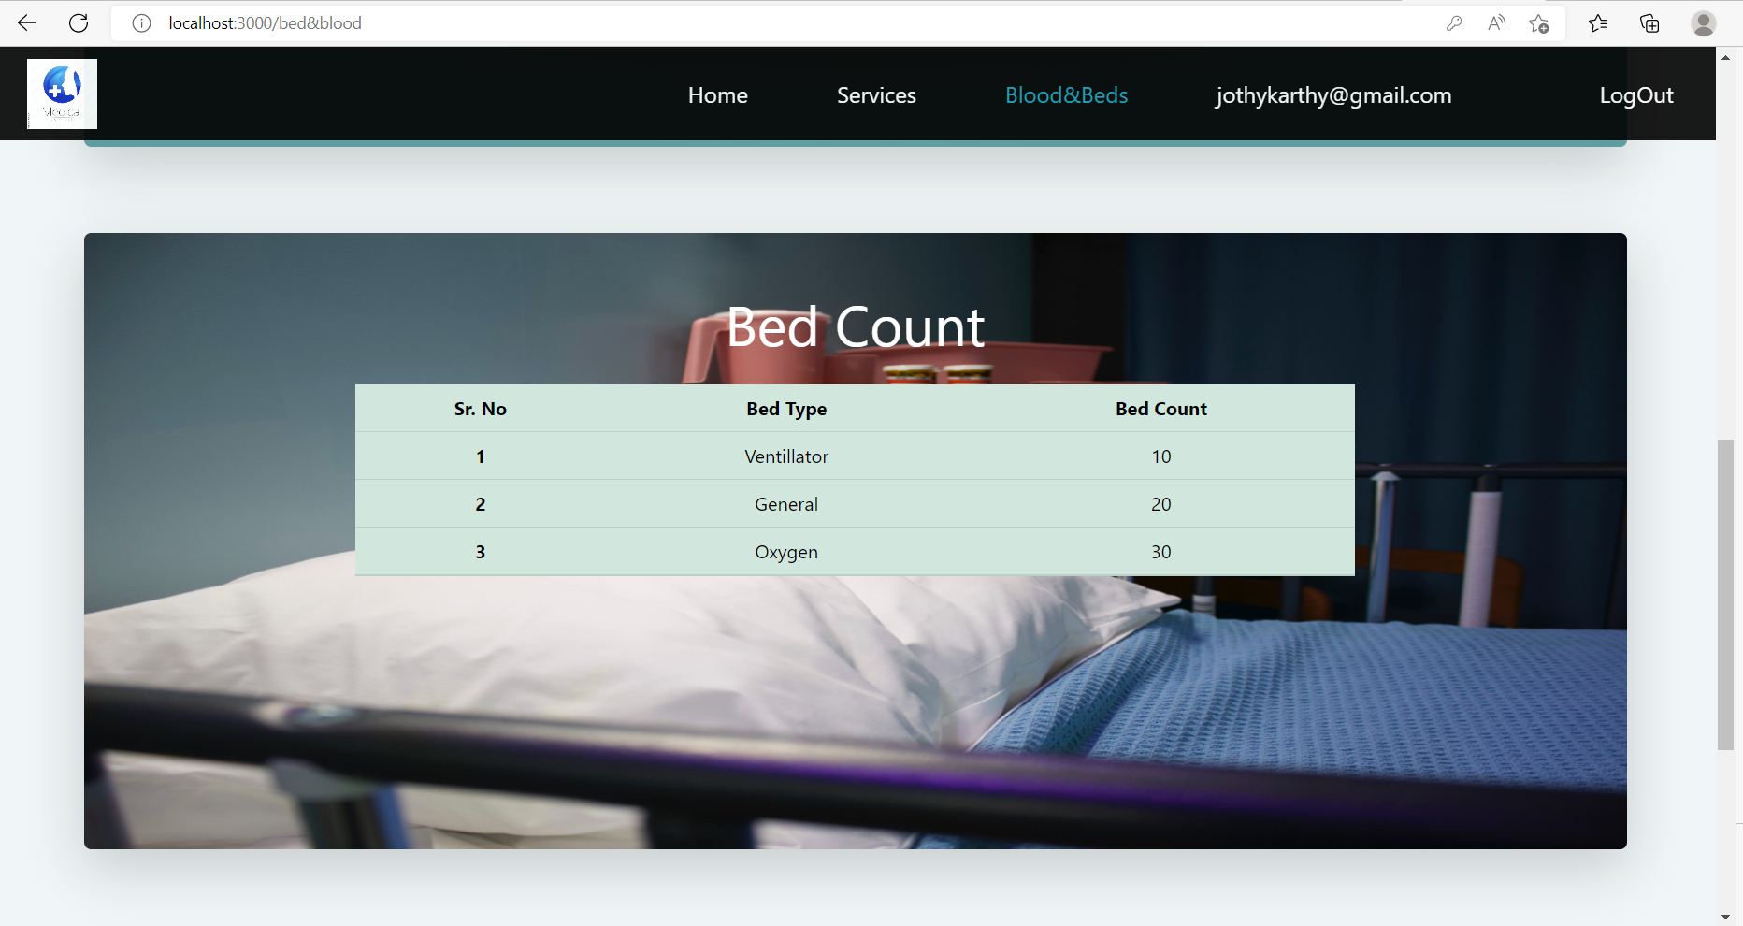
FRONTEND SCREENSHOTS:

Slide 26
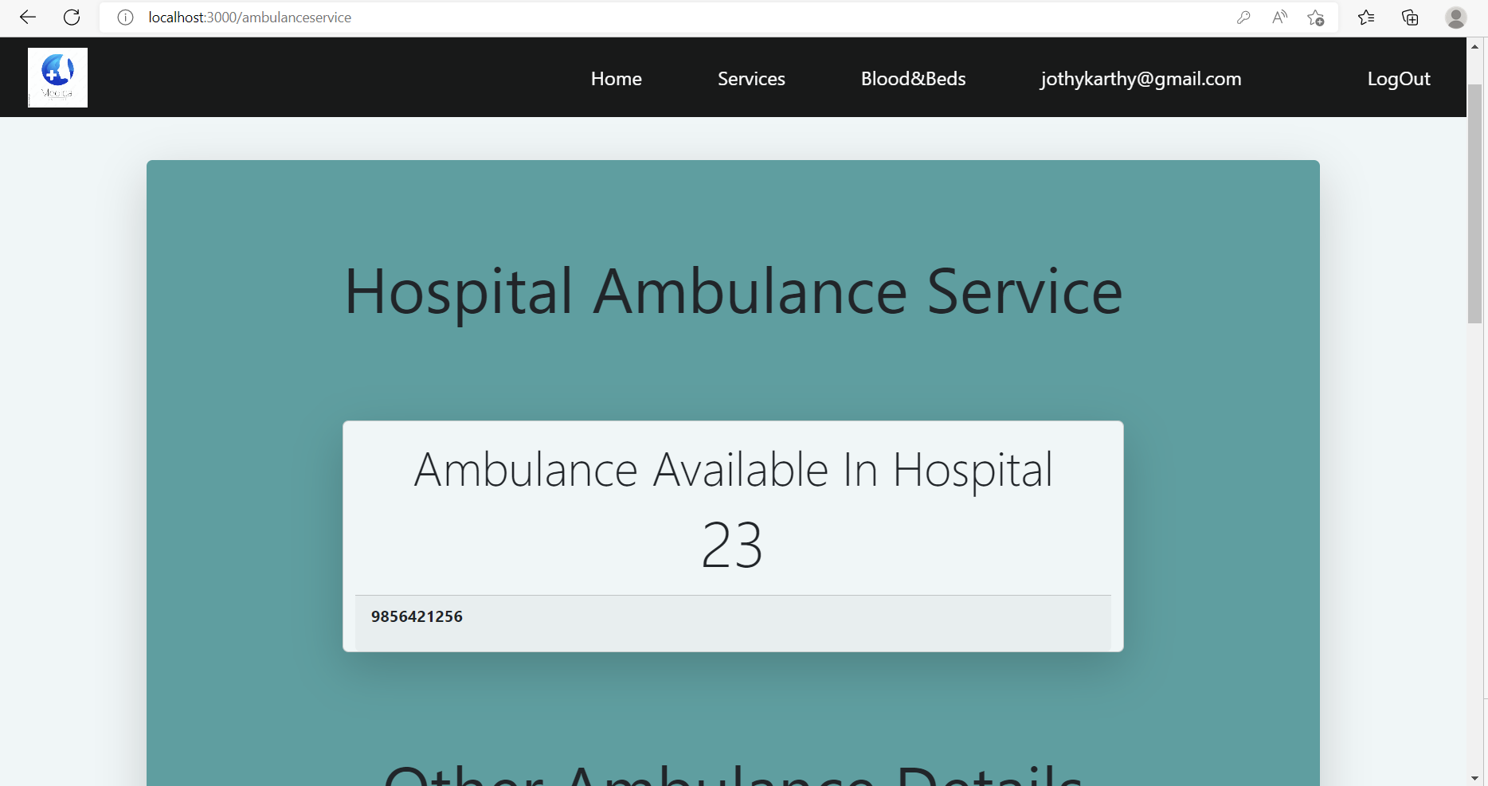
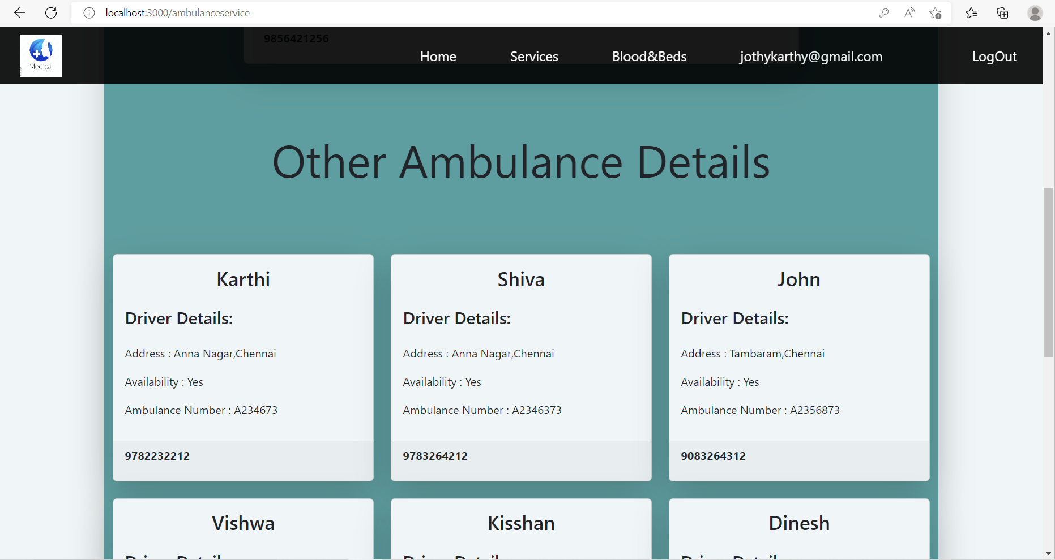
FRONTEND SCREENSHOTS:

Slide 27
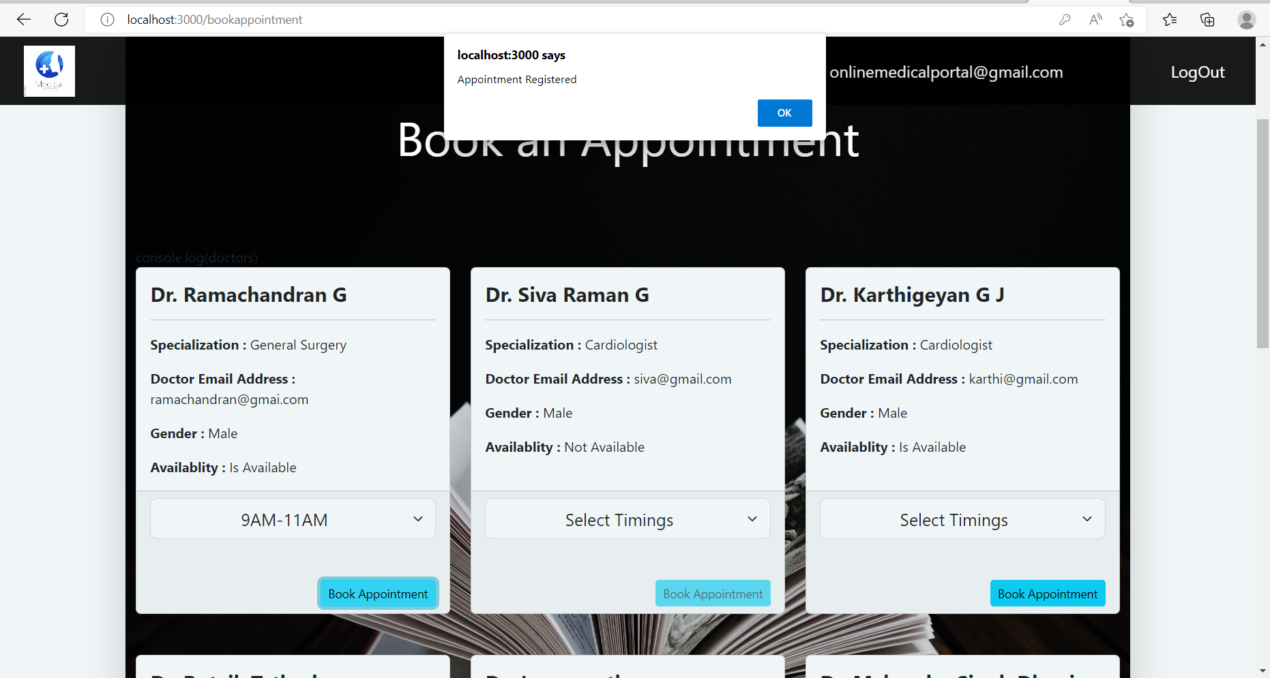
FRONTEND SCREENSHOTS:

Slide 28
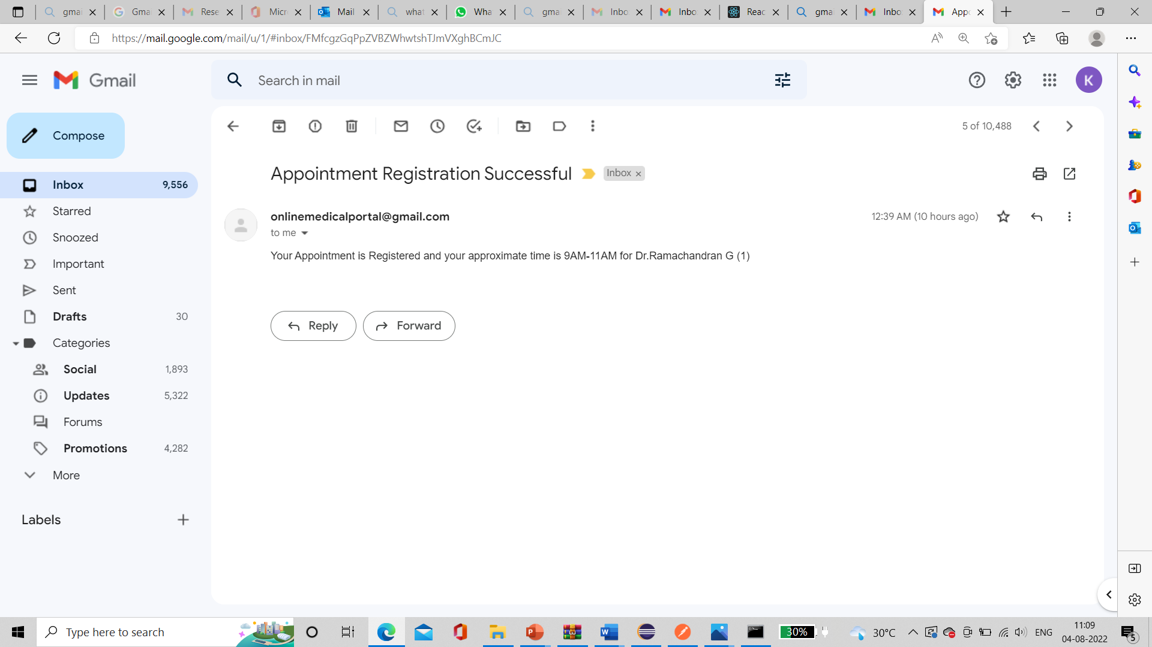
FRONTEND SCREENSHOTS:

Slide 29
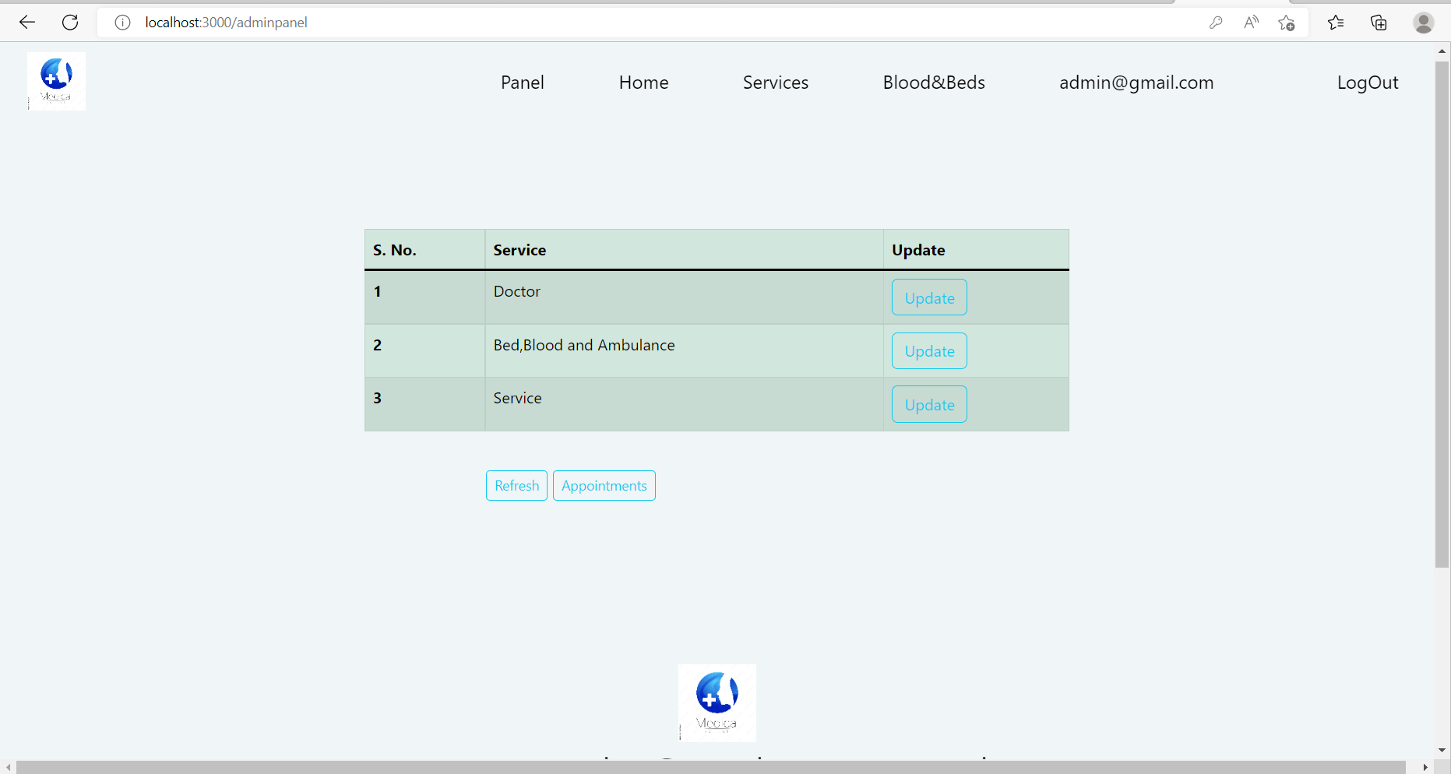
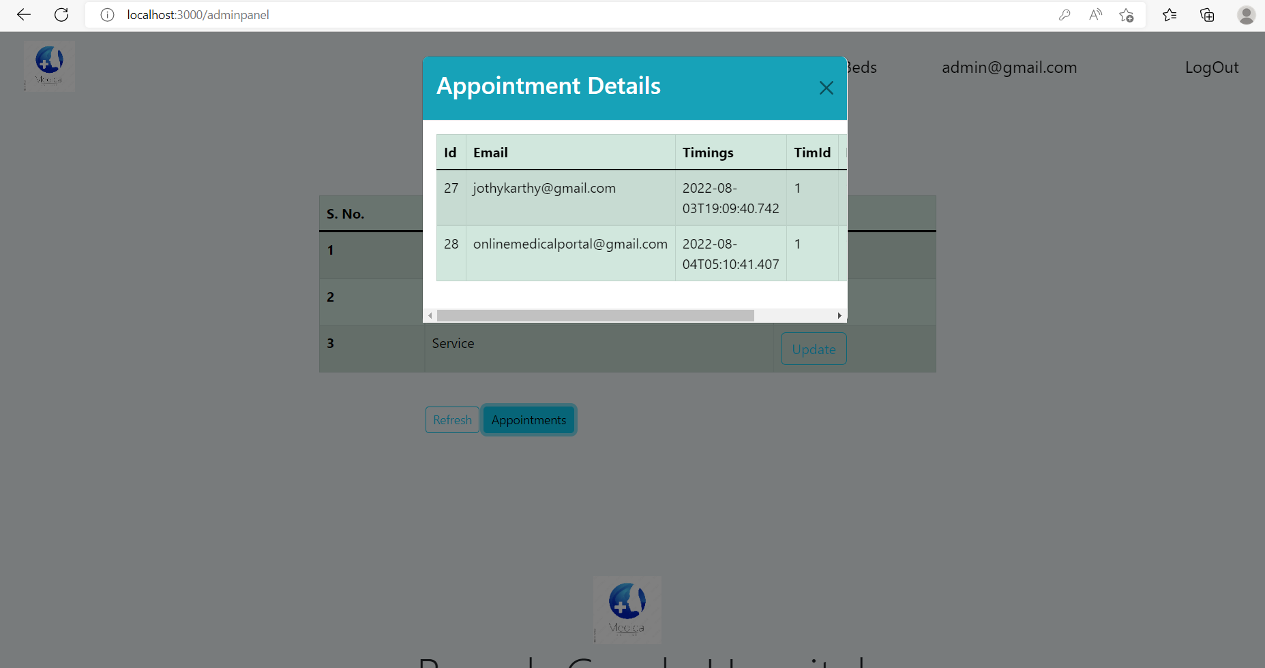
FRONTEND SCREENSHOTS:

Slide 30
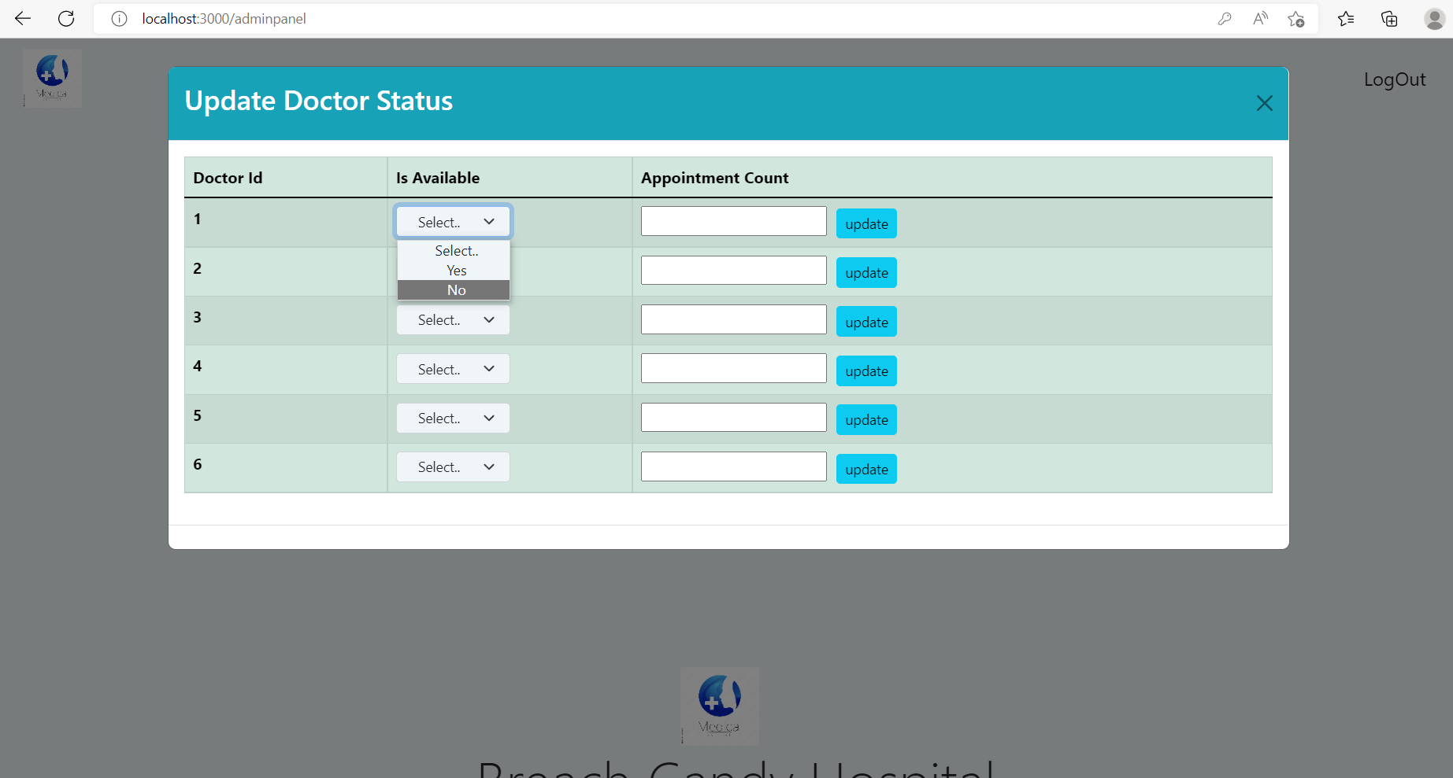
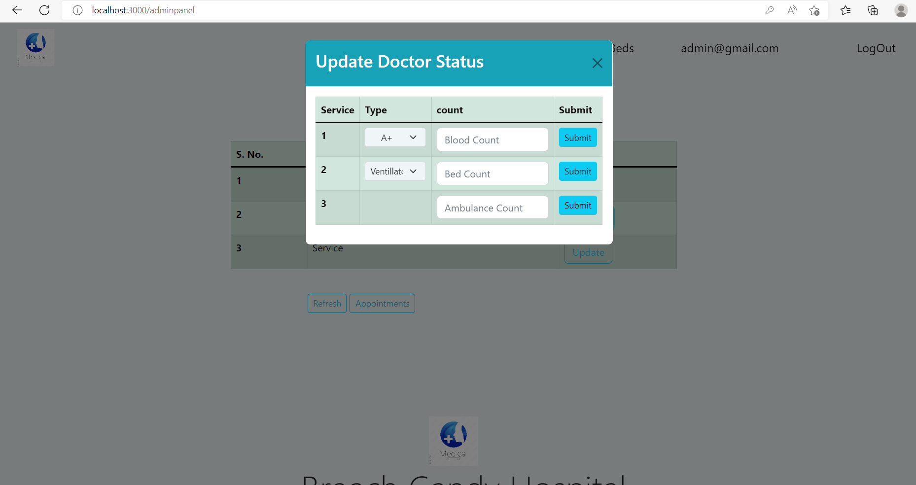
FRONTEND SCREENSHOTS:

Slide 31
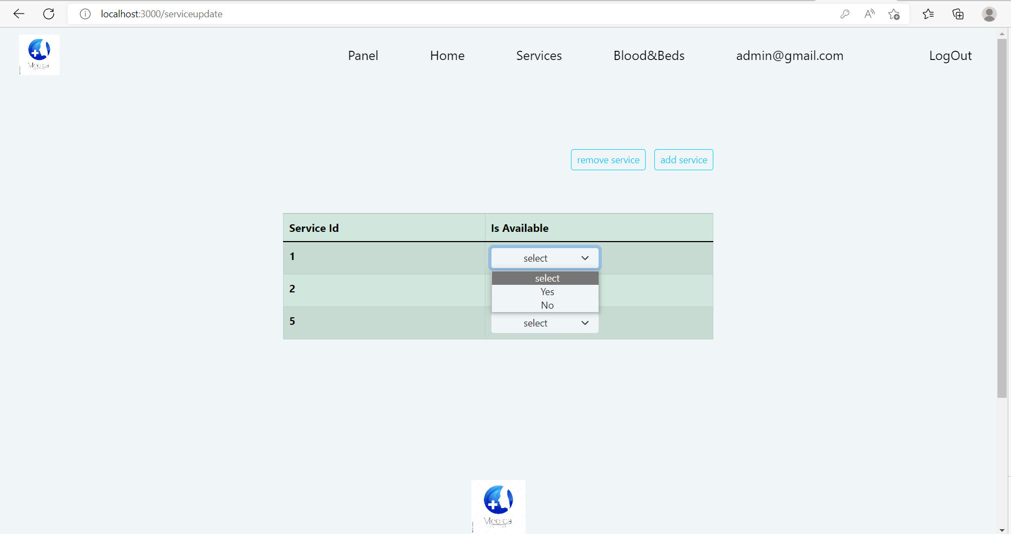
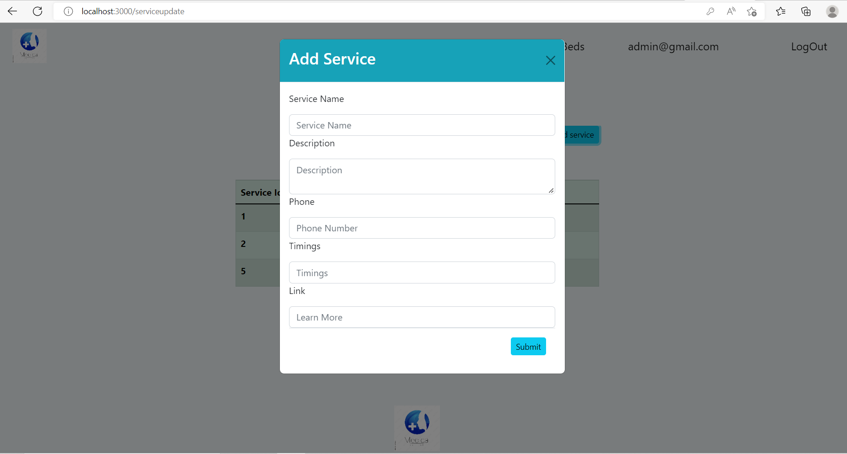
FRONTEND SCREENSHOTS:

Slide 32
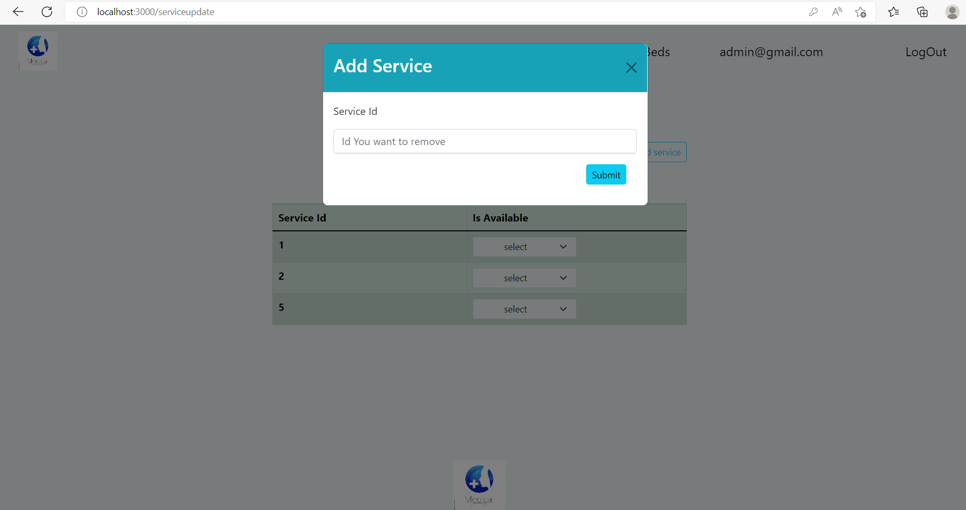
FRONTEND SCREENSHOTS:

Slide 33
THANK YOU

